Slide 1

CE303
Advanced Programming
Unit 4. Nov 8th, 2022.
Notes:
No escape from reality

Slide 2
Today:
Sockets and client/server architectures
Notes:
“Why should we care?” / “What will this unit enable us to do?”

Slide 3
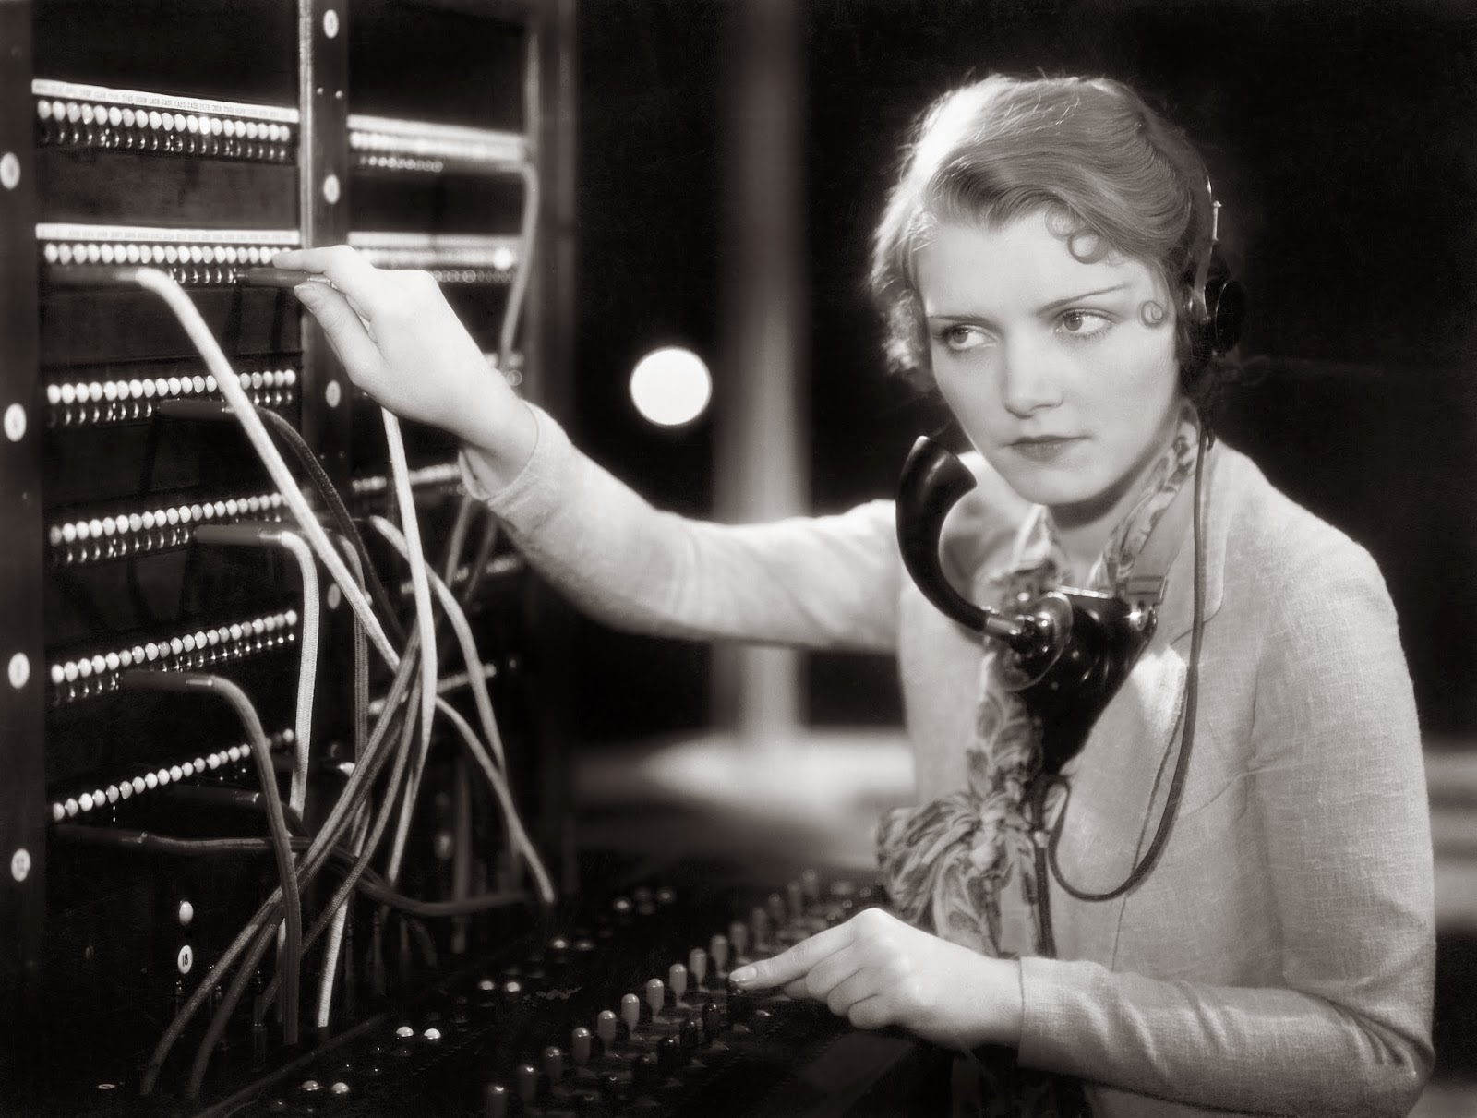
Notes:
Learn the mechanisms that allow us to communicate and exchange data between processes, so that we can build applications that communicate with other applications, across languages and devices.

Slide 4
Overview
Introduction to sockets and related concepts
Example of client-server program using sockets
We will dissect and study this carefully

Slide 5
BUT, FIRST,

Slide 6
BUT, FIRST,
Previously on CE303

Slide 7
import java.io.BufferedReader; import java.io.InputStreamReader; import java.io.IOException;
public class Main
{ public static void main( String [] args )
{ if (args.length == 0) { System.err.println( "Please provide input" ); System.exit(1); }
else if (args.length == 1 && args[0].equals("up") || args[0].equals("down")) { }
else { System.err.println( "Please use one of 'up' or 'down'" ); System.exit(1); }
BufferedReader b = new BufferedReader( new InputStreamReader( System.in ) );
String s;
try
{ while (true)
{ s = b.readLine(); if (s == null) { break; }
if (args[0].equals("up")) { System.out.println( s.toUpperCase() ); }
else { System.out.println( s.toLowerCase() ); }
}
}
catch (IOException e) { s = null; e.printStackTrace(); System.exit(1); }
}
}
Notes:
In some way, this is a server program; it expects a client to send it data externally, throught he standard input.
The server’s role is to take that data, process it in some way (e.g. convert to uppercase), and send it back out.

Slide 8
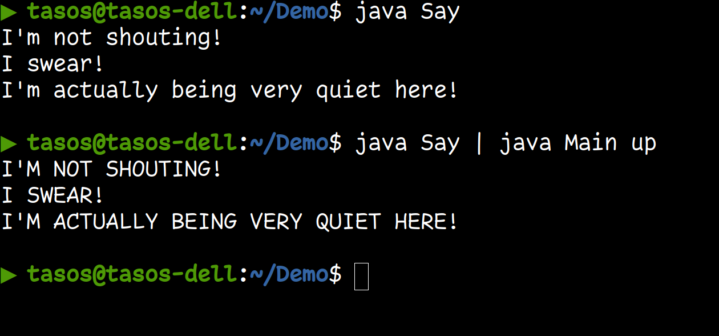
public class Say
{ public static void main( String [] args )
{ System.out.println( "I'm not shouting!" );
System.out.println( "I swear!" );
System.out.println( "I'm actually being very quiet here!" );
}
}
Note: If you try this on Windows, remember that you may have to specify the classpath explicitly, i.e. java -cp . Say | java -cp . Main up
Notes:
Here the ‘Say’ program can be thought of as a small client: it sends the text that it wants translated to uppercase to the ‘server’.
In reality we wouldn’t really call this a client/server architecture, but it’s useful to think about it in this way conceptually, to see how sockets make this communication more flexible and powerful.

Slide 9
Part I:
Introduction to internet sockets

Slide 10
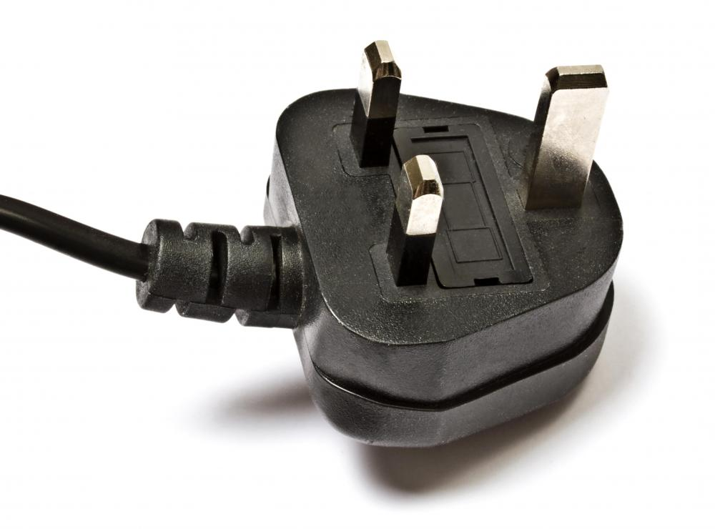
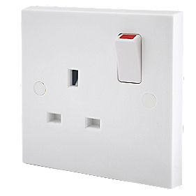
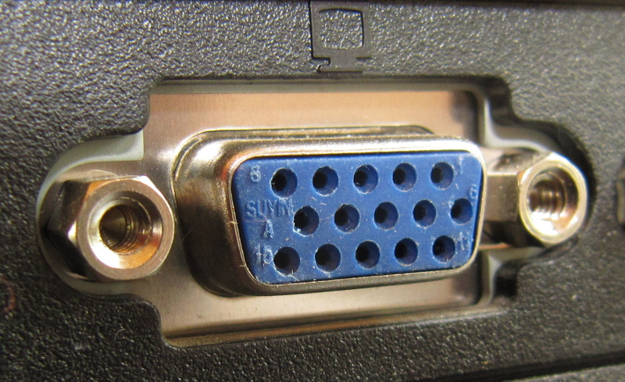
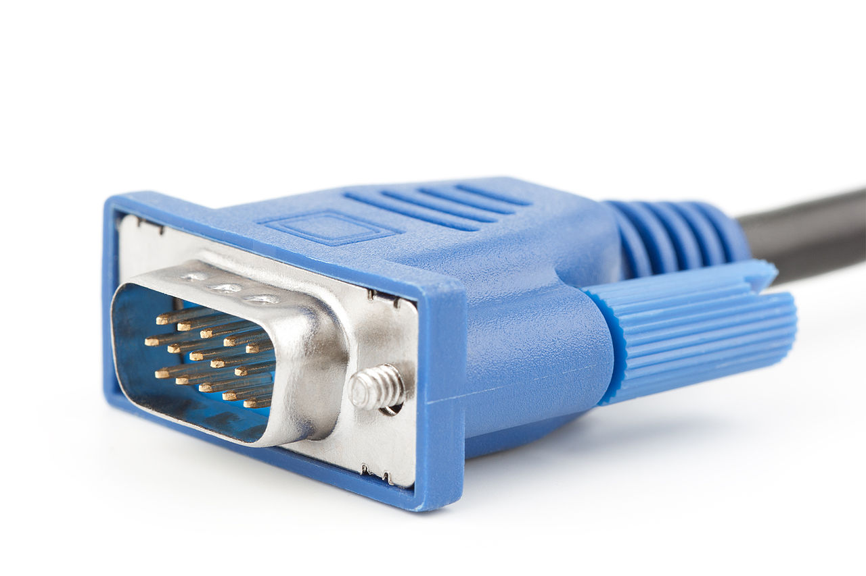
Sockets
Communication endpoints for exchanging data between processes
Inter-process (i.e. ‘local’) communication (e.g. Unix Domain Sockets - use local filesystem under the hood)
Network sockets (e.g. the Internet Protocol Suite – for exchanging data over the internet)
Others types (e.g. Bluetooth, infrared).
Typically all these use the same API, but differ in underlying implementation (Giving rise to Address Families: e.g. AF_UNIX, AF_INET, AF_IRDA etc)
More information if interested beyond network sockets: https://lists.freebsd.org/pipermail/freebsd-performance/2005-February/001143.html https://stackoverflow.com/questions/5815675/what-is-sock-dgram-and-sock-stream
Name alludes to physical ‘sockets’, e.g. transmitting electrical / digital signals
Like physical sockets, they have ‘connection’ and ‘send/receive’ semantics, and rely on particular communication protocols depending on the task type.
Notes:
AF: Address Family
The commonest type of socket is an internet socket, which is what we will be dealing with in this lecture.

Slide 11
Network sockets / Internet Protocol Suite
IPS: A set of communication protocols, which defines four layers of communication
Link Layer (protocols for linking to ‘physical’ components: MAC addresses, Ethernet/WiFi interface, etc)
Internet Layer (capturing / transmitting data packets between transport / link layers)
Transport Layer (provides end-to-end communication between processes)
Application Layer (protocols defining the type of the communication, e.g. http, ftp, smtp etc)
Sockets are defined at the Transport Layer:
Connection / Stream based: TCP
Uses the SOCK_STREAM interface
A two-way connection is established, then the two processes communicate via streams until the connection is terminated by one of the parties (or network error)
Promises to deliver multiple packets in the correct order. Inbuild error-checking, causing potential retransmission requests if packets are lost.
Connectionless / Datagram based: UDP
Uses the SOCK_DGRAM interface
A temporary connection is established to transmit a single message (datagram). No guarantees in terms of order, no checks for lost packets.
Lessreliable by design: less overhead, supports multicast (send to all subscribers) and broadcast (send to all on local network).
Local sockets are possible via a localhost mechanism.
Notes:
TCP: Transmission Control Protocol
UDP: User Datagram Protocol
We will be focusing on TCP in this module.
Mention that Localhost is still a ‘roundtrip’ (TCP is agnostic whether the package came from localhost or from the internet).

Slide 12
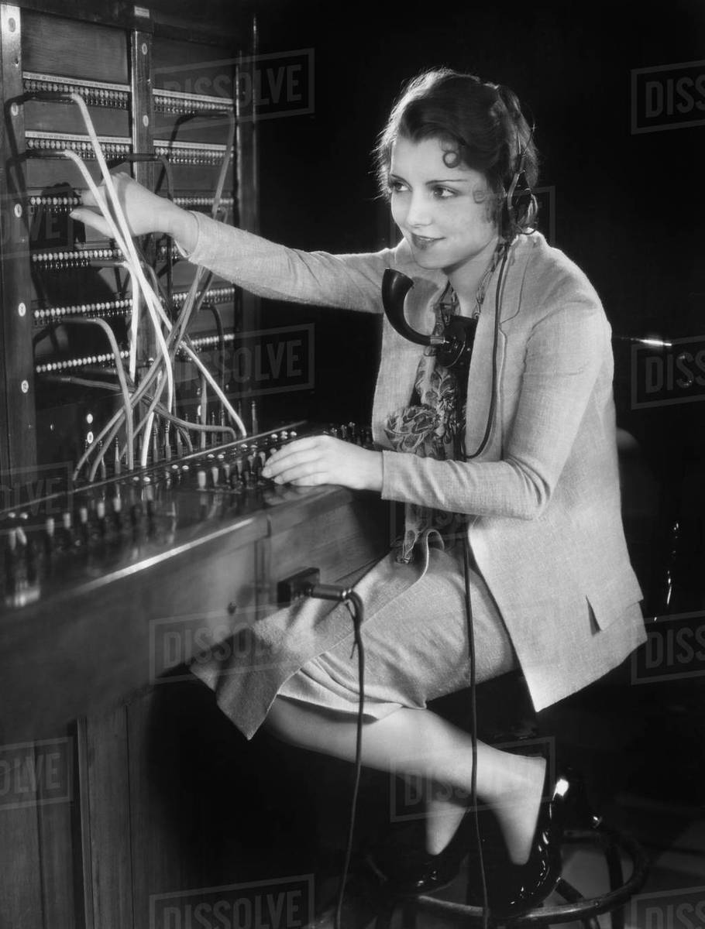
Ports
An internet socket is uniquely identified by
Its transport protocol (e.g. TCP)
Its internet (IP) address
Its port number.
Why ports?
A single computer can offer multiple services over the internet.
When data is received, it should be directed to the right process
A port is a number assigned to uniquely identify a connection endpoint and direct data to the relevant process
Internet Protocol specifies an integer between 0 and 65535 (i.e. 2¹⁶-1)
However, 0-1023 (i.e. 2¹⁰-1) are reserved for standard protocols (e.g. ftp:20, ssh:22, http:80, etc)
The sending program must know the port of the receiving program
This port number is included in the transmitted data
Ports can be blocked by “Firewalls” (allowing some user/admin control)
Notes:
An analogy here would be
TCP is the kind of switchboard (connection persists, allowing communication until operator disconnects)
IP address is calling the right switchboard / host
Port is plugging the connector on the right ‘port’ hole.
(note a single port might support multiple ‘streams’ – could be likened to phones with multiple ‘lines’ and ‘hold’ buttons)
If relevant, mention that ports are unique to internet sockets (e.g. unix sockets rely on files / inodes for uniqueness)

Slide 13
Client-Server Architectures
Typical scheme:
A server waits for clients to connect
The client connects and uses a service provided by the server.
Ideal scenario for communication via sockets
Client-Server example in the real world: WWW (http)
Client: Browser program providing a user interface, simple validation, JavaScript engine …
Server: remote HTTP server, providing static or dynamic web content, access control, concurrent access …
Typical procedure:
A server creates a socket, and ‘binds’ a port for its use
The server is then asked to “listen” at that port
(i.e. mark the socket/port as ‘passive’, meaning one that will be used to accept incoming connection requests)
The client takes the initiative to connect to a ‘listening’ server at its listening port.
The server needs to ‘accept’ the incoming connection
If the server ‘refuses’ (e.g. maximum limit of connections reached when ‘listening’), client may exit with an error, or attempt to reconnect, depending on implementation.
Notes:
In theory this could be done using other streams (e.g. remember the uppercasing example from the previous lecture).
But sockets give us a lot more control.

Slide 14
Socket-based Client-Server architectures
The socket acts as a bi-directional connection between the client and the server.
Typically via a TCP connection
Can be used to transmit information across processes
This could be from different programming languages / running on different platforms.
The socket is associated with / establishes input/output streams
(one input/output pair per connection)
A server listening for connections can accept connections from multiple clients at the same port
But the clients will typically have different IP addresses / port numbers at their point of origin
This establishes a bi-directional communication channel between the specific server / client port pair.
Server can distinguish between different client connections via the different client port numbers.
Notes:
Compare to switchboard example:
King Charles listens for calls to his private line (server port)
Prime Minister (client port) from 10 Downing (client address) calls Buckingham Palace (server address) asking to be connected to King Charles (server port).
Telephone operator asks King Charles (privately) if he will accept the call. The King accepts. The operator connects the call on one of the slots corresponding to the King’s port.
The Shadow PM wants to call the King too. He calls, and the operator gets permission, and connects the call to the King (this establishes a separate line, i.e. input/output stream)
The King wants to receives the message from the ShadowPM, and then wants to say something back to the PM. He speaks to the PM line specifically (PM port).

Slide 15
Part II:
Bank Server example
Notes:
Any questions?
FIRE UP HORIZON BEFORE PROCEEDING, so that login has finished by the time you do the demo!

Slide 16
Bank Server
Example of a simple ‘banking application’
One server, multiple concurrent clients
Each client is a separate process, possibly running on a different machine
When you develop a client-server application, you need to design a ‘protocol’ for the client-server interaction
Typical recommended approach
Base protocols on methods of accessed objects
Make sure there is a clean separation of functionality between server and clients.
(note: the source code for the bank server example will be on moodle alongside the lecture)
Notes:
FIRE UP HORIZON if you haven’t!

Slide 17
(DEMO)
Notes:
OMG YOU STILL HAVEN’T FIRED UP HORIZON???

Slide 18
// Account.java
public class Account {
private final int customerId; private final int accountNumber; private int balance;
public Account(int customerId, int accountNumber)
{ this.accountNumber = accountNumber;
this.customerId = customerId;
}
public int getAccountNumber() { return accountNumber; }
public int getCustomerId() { return customerId; }
public int getBalance() { return balance; }
public void setBalance( int newBalance ) { balance = newBalance; }
}
// Bank.java
import java.util.ArrayList; import java.util.List; import java.util.Map; import java.util.TreeMap;
public class Bank
{ private final Map<Integer, Account> accounts = new TreeMap<>();
public void createAccount( int customerId, int accountNumber, int initialBalance )
{ Account account = new Account( customerId, accountNumber );
account.setBalance( initialBalance );
accounts.put( accountNumber, account );
}
public List<Integer> getListOfAccounts( int customerId )
{ List<Integer> result = new ArrayList<Integer>();
for (Account account : accounts.values())
{ if (account.getCustomerId() == customerId)
{ result.add( account.getAccountNumber() );
}
}
return result;
}
public int getAccountBalance( int customerId, int accountNumber ) throws Exception
{ if (accounts.get(accountNumber).getCustomerId() != customerId)
{ throw new Exception( "Account " +accountNumber+
" belongs to a different customer; customer " +customerId+
" is not authorised to query balance for this account." );
}
return accounts.get(accountNumber).getBalance();
}
public void transfer( int customerId, int fromAccount, int toAccount, int amount ) throws Exception
{ synchronized (accounts)
{ if (accounts.get( fromAccount ).getCustomerId() != customerId )
{ throw new Exception( "Account " +fromAccount+
" belongs to a different customer; customer " +customerId+
" is not authorised to transfer from this account." );
}
if (accounts.get( fromAccount ).getBalance() < amount)
{ throw new Exception( "The balance of account " +fromAccount+
" is " +accounts.get(fromAccount).getBalance()+
" which is insufficient to transfer " +amount+ "." );
}
if (amount <= 0)
{ throw new Exception( "Transfer amount has to be a positive value." );
}
accounts.get( fromAccount ).setBalance( accounts.get( fromAccount ).getBalance() - amount );
accounts.get( toAccount ).setBalance( accounts.get( toAccount ).getBalance() + amount );
}
}
}

Slide 19
// ClientProgram.java
import java.util.Scanner;
public class ClientProgram
{ public static void main( String[] args )
{ System.out.println( "Enter your customer ID:" );
try
{ Scanner in = new Scanner( System.in );
int customerId = Integer.parseInt( in.nextLine() );
try (Client client = new Client( customerId ) )
{ System.out.println( "Logged in successfully." );
while (true)
{ int [] accountNumbers = client.getAccountNumbers();
System.out.println( "Your accounts:" );
for (int account : accountNumbers)
{ System.out.printf( " Account %5d: balance %10d GBP%n", account, client.getBalance( account )); }
System.out.println( "Enter the account number to transfer from or -1 to print the account list:" );
int fromAccount = Integer.parseInt( in.nextLine() );
if (fromAccount < 0) { continue; }
System.out.println( "Enter the account number to transfer to (this could be someone else's account):" );
int toAccount = Integer.parseInt( in.nextLine() );
System.out.println( "Enter the amount to be transferred:" );
int amount = Integer.parseInt( in.nextLine() );
client.transfer( fromAccount, toAccount, amount );
}
}
} catch (Exception e) { System.out.println(e.getMessage()); }
}
}

Slide 20
// Client.java
import java.io.*; import java.net.Socket; import java.util.Scanner;
public class Client implements AutoCloseable // i.e. can use in a try-with-resources block
{ final int port = 8888; private final Scanner reader; private final PrintWriter writer;
public Client( int customerId ) throws Exception {
Socket socket = new Socket( "localhost", port ); // Connecting to the server,
reader = new Scanner( socket.getInputStream() ); // and create objects for communications;
writer = new PrintWriter( socket.getOutputStream(), true ); // Provides nice 'println' functions (which flush automatically!)
writer.println( customerId ); // Send customer ID
String line = reader.nextLine(); // Parse the response
if (line.trim().compareToIgnoreCase( "success" ) != 0) throw new Exception( line );
}
public int [] getAccountNumbers()
{ writer.println( "ACCOUNTS" ); // Send "command"
String line = reader.nextLine(); // Read response (expecting: number of accounts)
int numberOfAccounts = Integer.parseInt( line ); // Parse response
int [] accounts = new int[ numberOfAccounts ]; // Create array to hold accounts
for (int i = 0; i < numberOfAccounts; i++)
{ line = reader.nextLine(); accounts[ i ] = Integer.parseInt( line ); } // Populate accounts
return accounts; // Return accounts array (or, to be exact, a reference to the array)
}
public int getBalance( int accountNumber )
{ writer.println( "BALANCE " + accountNumber); // Send "command"
String line = reader.nextLine(); // Read response (expecting: balance)
return Integer.parseInt(line); // Parse Response
}
public void transfer( int fromAccount, int toAccount, int amount ) throws Exception
{ writer.println( "TRANSFER " +fromAccount+ " " +toAccount+ " " +amount); // Send command
String line = reader.nextLine(); // Read response (expecting: 'success')
if (line.trim().compareToIgnoreCase( "success" ) != 0) throw new Exception( line );
}
@Override
public void close() throws Exception { // Implement AutoCloseable interface!
reader.close();
writer.close();
}
}

Slide 21
// ServerProgram.java
import java.io.IOException; import java.net.ServerSocket; import java.net.Socket;
public class ServerProgram
{ private final static int port = 8888;
private static final Bank bank = new Bank();
public static void main(String[] args)
{ bank.createAccount( 1, 1001, 100 );
bank.createAccount( 1, 1002, 200 );
bank.createAccount( 2, 1003, 150 );
bank.createAccount( 3, 1004, 50 );
RunServer();
}
private static void RunServer()
{ ServerSocket serverSocket = null; // passive socket, used for 'listening'
try
{ serverSocket = new ServerSocket( port ); // bind port and start listening
System.out.println( "Waiting for incoming connections..." );
while (true)
{ Socket socket = serverSocket.accept(); // accept incoming connections (blocks until it does!)
new Thread( new ClientHandler( socket, bank ) ).start();
}
}
catch (IOException e) { e.printStackTrace(); }
}
}

Slide 22
// ClientHandler.java
import java.io.PrintWriter; import java.net.Socket; import java.util.List; import java.util.Scanner;
public class ClientHandler implements Runnable
{ private final Socket socket;
private Bank bank;
public ClientHandler( Socket socket, Bank bank ) { this.socket = socket; this.bank = bank; }
@Override
public void run()
{ int customerId = 0;
try (Scanner scanner = new Scanner( socket.getInputStream() );
PrintWriter writer = new PrintWriter( socket.getOutputStream(), true ) )
{ try
{ customerId = Integer.parseInt( scanner.nextLine() );
System.out.println( "New connection; customer ID " + customerId );
if (bank.getListOfAccounts( customerId ).size() == 0)
{ throw new Exception( "Unknown customer: " + customerId + "." );
}
writer.println( "SUCCESS" );
while (true)
{ String line = scanner.nextLine();
String[] substrings = line.split(" ");
switch (substrings[0].toLowerCase())
{ case "accounts":
List<Integer> listOfAccounts = bank.getListOfAccounts( customerId );
writer.println( listOfAccounts.size() );
for (Integer accountNumber : listOfAccounts) { writer.println(accountNumber); }
break;
case "balance":
int account = Integer.parseInt( substrings[ 1 ] );
writer.println( bank.getAccountBalance( customerId, account ) );
break;
case "transfer":
int fromAccount = Integer.parseInt( substrings[ 1 ] );
int toAccount = Integer.parseInt( substrings[ 2 ] );
int amount = Integer.parseInt( substrings[ 3 ] );
bank.transfer( customerId, fromAccount, toAccount, amount );
writer.println( "SUCCESS" );
break;
default: throw new Exception( "Unknown command: " + substrings[ 0 ] );
}
}
}
catch (Exception e) { writer.println( "ERROR " + e.getMessage()); socket.close(); }
}
catch (Exception e) { }
finally { System.out.println( "Customer " + customerId + " disconnected." ); }
} // end of 'run' method
}

Slide 23
Bank Server: Protocol Outline
It is a client-server application, i.e. the client initiates a connection
The protocol is text-based, i.e. not binary
The server never initiates an exchange of data; every exchange is initiated by the client, and the server immediately responds to each client request
The protocol does not include any authentication
Obviously this would be unacceptable in real world!
Each client request consists of a single text line
Server response can be a single text line or multiple lines, depending on the request (see the table on the next slide)
In case of an error, the server responds with a line “ERROR” followed by an error message

Slide 24
Bank Server: Protocol Outline
Client request | Server response (if success)
(On connection) <customer ID> | “SUCCESS”
ACCOUNTS | <Number of accounts> <Account 1> <Account 2> …
BALANCE <account> | <Account balance>
TRANSFER <from account> <to account> <amount> | (Perform transfer) “SUCCESS”
Notes:
Remember earlier we said it is recommended for protocol functionality to mirror methods in the respective program

Slide 25
Processes and threads
The server and each client are separate processes
In Java, one could have both programs in one package, however we’ve split them into two completely independent projects so that you do not confuse the server and the client processes
Each client runs a single thread
The server has its main thread for listening for new connections and one additional thread for each connected client – to process the requests from that specific client

Slide 26
Processes and threads diagram
Establishing
TCP connection
Client 1 process
Server process
Main thread – UI and communications
Main thread – listens to new connections
Notes:
Note that there is a “dialogue” happening here! The client sends a request, the server listens, acts on the request and responds. So when coding we need to be coding these commands in a sequential order.

Slide 27
Processes and threads diagram
Client 1 process
Server process
Main thread – UI and communications
Main thread – listens to new connections
Handling client 1

Slide 28
Processes and threads diagram
Client 1 process
Server process
Main thread – UI and communications
Main thread – listens to new connections
Client 2 process
Handling client 1
Main thread – UI and communications
Handling client 2

Slide 29
Processes and threads diagram
Client 1 process
Server process
Main thread – UI and communications
Main thread – listens to new connections
Client 2 process
Handling client 1
Main thread – UI and communications
Client 3 process
Handling client 2
Main thread – UI and communications
Handling client 3

Slide 30
Server Main Thread
The server waits for clients to connect on a certain port
This port number is 8888 in case of our bank server
To listen for incoming connections, create a server socket for that port and call accept()
This will block until a client connects
When a client connects, it will return a Socket object
ServerSocket is just for setting up the connection
Application data is exchanged in Socket objects
The ClientHandler class handles the interaction

Slide 31
ClientHandler thread
The server runs a thread (the ClientHandler class) for each connected client
ClientHandler is created after a client application connects and runs until it disconnects
It handles all the communications with the client:
At the beginning, it receives the customer ID
Then, in an infinite loop, it waits for commands
It uses a switch statement to process commands
Every time the server receives a command, it responds according to the protocol

Slide 32
ClientProgram class
The main() method is responsible for the UI:
Prompts the customer ID before connecting to the server
Displays the list of accounts with balances
Allows transferring funds
All the communications with the server are delegated to the Client class
This is a convenient architecture that separates the UI from the communication layer

Slide 33
Client Class
Call Socket constructor to connect to server
Socket socket = new Socket("localhost", port);
throws UnknownHostException if the host is not found
Use input/output streams attached to socket to communicate with other endpoint
reader = new Scanner(socket.getInputStream());
writer = new PrintWriter(socket.getOutputStream(), true);
When you send data to writer, the socket forwards it to the server; you can read the server's response (if any) through reader
When communication with the server ends, close the socket
socket.close();

Slide 34
General remarks about Text Protocols / Formats
Strong points
Human readable and editable
Easily interchangeable with other platforms
Support for standardised / legacy text formats
Easy to test with external programs (more on this in the next slide)
Weak points
Usually less efficient than binary formats
Unless the description of the format is precise, there can be compatibility issues
Note
Text formats rely on a character encoding; the default encoding in Java is UTF-8
You can specify other encodings

Slide 35
Testing text-based client-server applications in the terminal
You don’t have to implement a full-blown client just to test sending commands!
There are many interfaces you can use to connect directly to a socket and type/receive text
Useful for debugging!
E.g. telnet (telnet localhost 8888)
netcat (nc localhost 8888) / (nc -l localhost 8888 # for a listening socket)
Directly from a bash terminal! (echo "text!" > /dev/tcp/localhost/8888)
see: https://who23.github.io/2020/12/03/sockets-in-your-shell.html
Telnet:
Is an ‘application layer’ internet protocol (and a program for accessing said protocol)
Historically used to execute commands on a remote server
But Telnet has security problems, notably lack of encryption and proper authentication
Hence is has been largely replaced by SSH
Telnet can be used as a basic client when developing applications that communicate text over sockets
Both Windows and Unix come with Telnet clients (may require installation/setup before you can use them)
Putty is a popular SSH and Telnet client for Windows and Unix platforms
Notes:
Demo with telnet
And also debugging with jdb if there is time = demonstrate Serverprogram:23 that socket has port and localport

Slide 36
Sockets – summary and final thoughts
Socket communication works across different computer architectures and different programming languages
Java socket programming is fairly straightforward:
server socket listens for connection requests from clients
sockets have input/output streams for exchanging data
Unresponsive sockets can block a thread
use time-outs
Applications need to agree on protocols
Serialisation-based protocols will often have compatibility issues
Text stream handling can be awkward due to formatting, string composition and parsing, handling delimiters, new lines, flushing of output streams, etc.
More high level frameworks for distributed computing like web services or RMI are built on top of sockets
Notes:
(RMI: Remote Method Invocation – a java specific way that allows one JVM instance to communicate with another)

Slide 37
Summary
Introduction to Sockets
Example of client-server application
ServerProgram and ClientHandler threads (for concurrency)
ClientProgram and Client (separation of responsibilities).
Testing and debugging with external programs.

Slide 38
Academic hours: Wednesdays 09:00-11:00 (please email if you can)
Notes:
Announcement that assignment has been released!
Also remind progress tests on week 7 (Monday!)
(show moodle page?)

